Slide 1
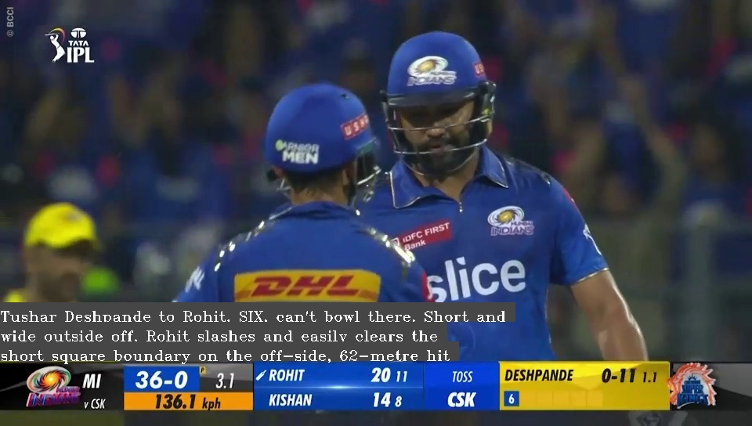
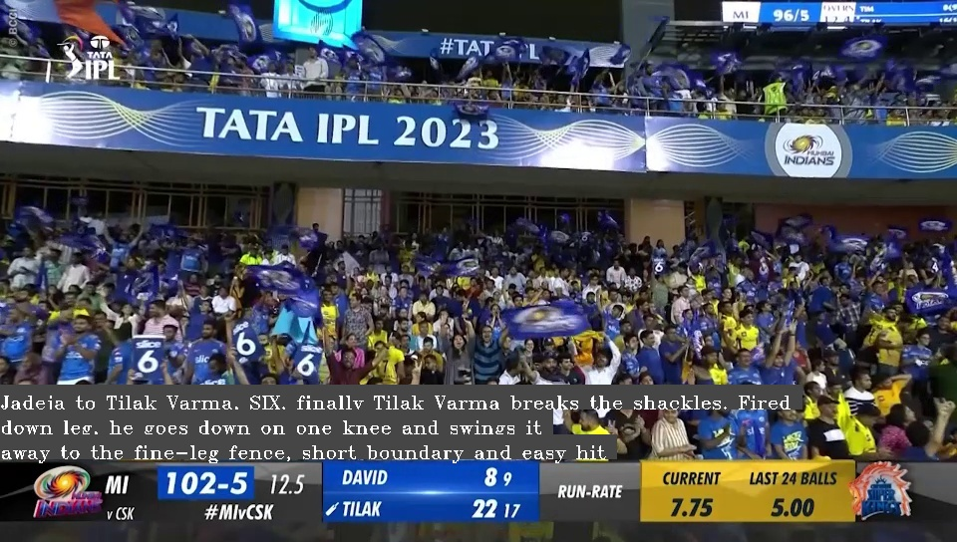
Cricket Commentary Project
Superimposing cricket commentary texts on to the corresponding frames of the highlight video.

Slide 2
Overview
We selected a highlight video of an ipl match and the commentary file of that match. We saved the commentary as a text file and downloaded the video.
Using OpenCV, we divided the video into multiple frames.
We used Easy-OCR to read the over number/ ball number at the bottom of each frame.
The commentary looked somewhat like this:
3.1
Tushar Deshpande to Rohit, SIX, can't bowl there. Short and wide outside off, Rohit slashes and easily clears the short square boundary on the off-side, 62-meter hit.

Slide 3
Overview
5. Then we filtered the commentary text file into separate files having the commentary of 6s and 4s using the keywords “SIX” and “FOUR” and saved them in a dictionary for easy access, where the ball number was the key and the value was the commentary.
We compared the read ball number in the frame with the ball number in the commentary dictionary.
When the read ball number of the frame was equal to the ball number in the dictionary (key), the commentary (value) corresponding to that ball (value) was superimposed on to the frame.
Hence the commentary will appear on the frames until that ball number is present on the frames.

Slide 4
Selecting highlight video and copying commentary into a text file
Filtering the commentary based on keywords
Splitting video into frames using OpenCV
Storing the commentary into dictionary
Matching the read over no with the dictionary key and superimposing the commentary
Iterating through frames and reading over no
Setting up EasyOCR Reader

Slide 5
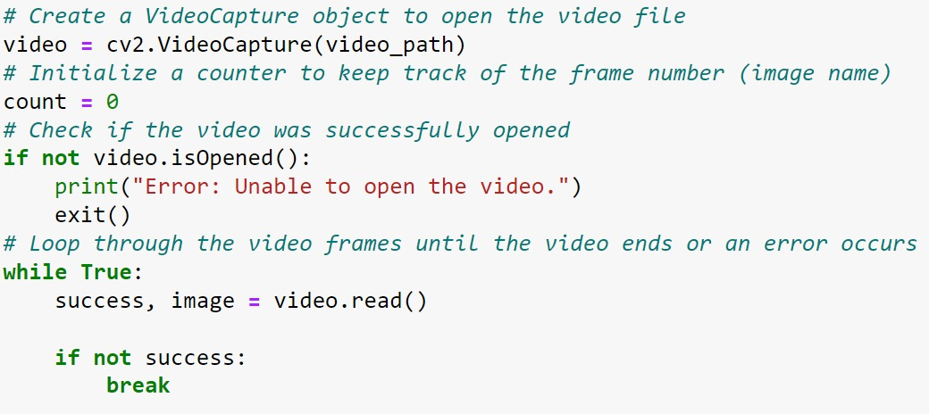
Working
Dividing video into frames using OpenCV and saved all the frames into a folder.
Filtered the commentary based on keywords such as “SIX”, “FOUR”, “THAT’S OUT”, etc.

Slide 6
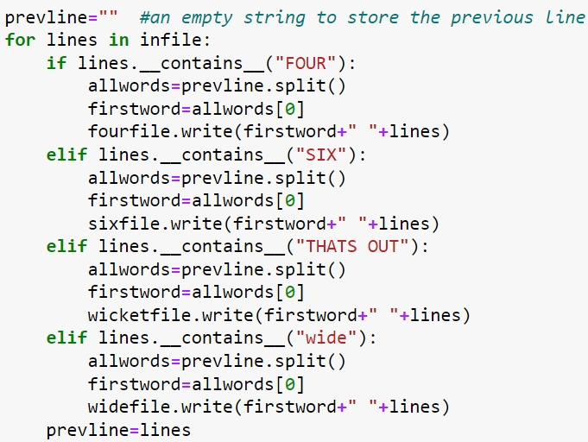
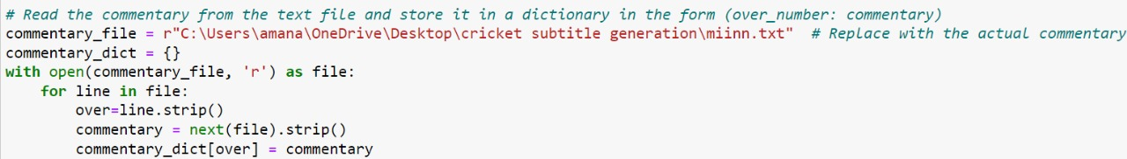
Working
Then we stored the commentary in a dictionary.

Slide 7
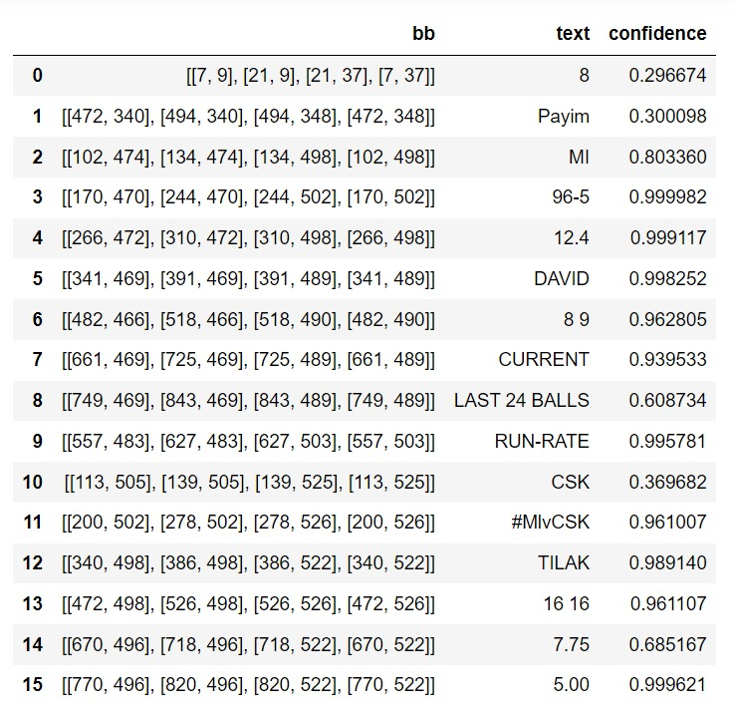
Working
We set up the Easy-OCR reader/pipeline.
Iterated trough the frames folder and ran the Easy-OCR reader over every frame.
This gives us a data-frame consisting of the bounding box coordinates, contents of the bounding box and the accuracy.

Slide 8
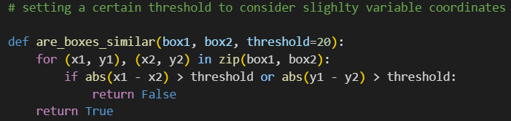
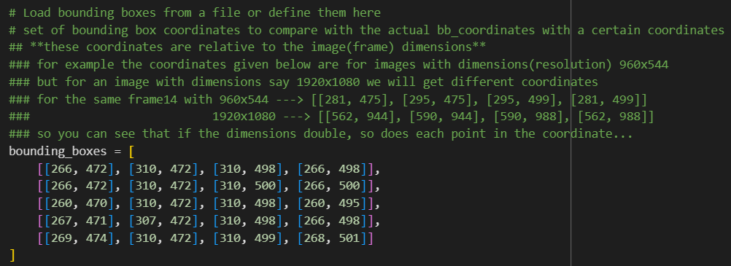
Working
5. Using the coordinates of the bounding box corresponding to the over number, we found an interval between which the bounding boxes of the other frames would lie and retrieved only the contents belonging to those bounding boxes.

Slide 9
Original Bounding Box
Extended Bounding Box with threshold of 20px
20px

Slide 10
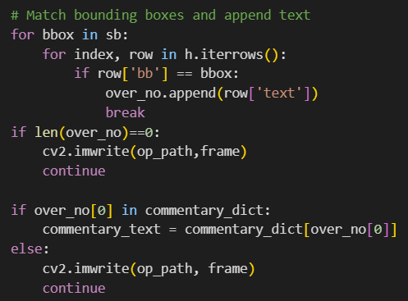
Working
We matched the contents (over number) of the desired bounding box with the key (over number) of the dictionary and superimposed the value (commentary text) of that corresponding ball onto the frame.

Slide 11
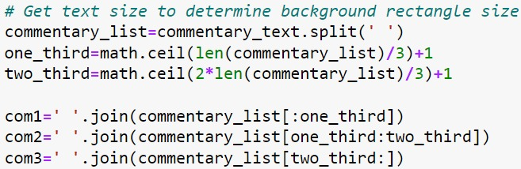
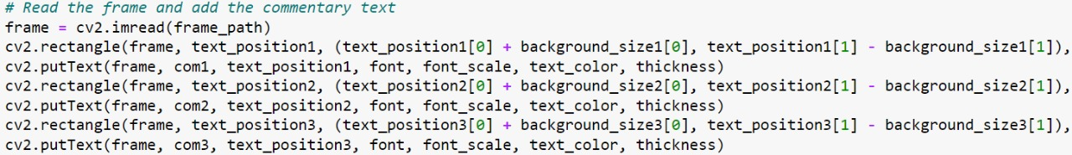
Challenges Faced
Initially, through trial and error method we tried to manually draw the bounding boxes around the ball/over numbers of each frame and read the contents in that bounding box using Tesseract-OCR. This wasn’t working. We overcame this by using Easy-OCR.
The commentary, while being superimposed was moving out of the frame. This was overcome by splitting the commentary text into multiple lines.

